Slide 1
Nuclear Fuel Performance
NE 533: Spring 2023

Slide 2
Last Time
Mining -> Processing -> Conversion -> Enrichment -> Powder -> Compaction/Sintering -> Rod/Assembly
U₃O₈ must be converted to UF₆ for enrichment, which is then converted to UO₂ powder for pellet manufacture
For different fuel types, enriched UF₆ follows a different path

Slide 3
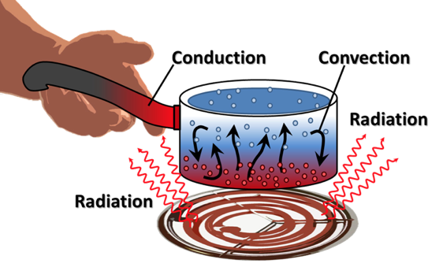
Last Time
General heat transport
Heat is produced in the fuel, transports through the gap and cladding, and into the coolant
The geometry of our problem
The initial condition of T
The boundary conditions of T
Is each parameter is a function of T
Thermal conductivity, heat capacity
Function of space/time?
Heat generation, dependent upon flux

Slide 4
Analytical solve of heat conduction

Slide 5
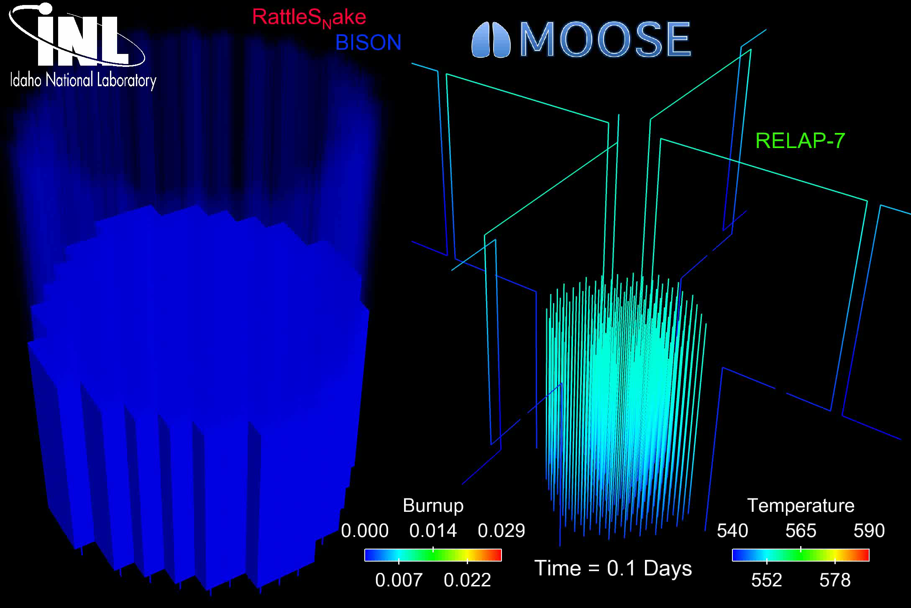
The most accurate solution is numerical, in 3D, requires modeling the entire core, and is multi-physics
Solution is 3D and changes in time
All the properties are functions of temperature
The boundary conditions comes from information about the coolant flow
The heat generation rate comes from information about the neutronics in the reactor
No analytical solution is possible

Slide 6
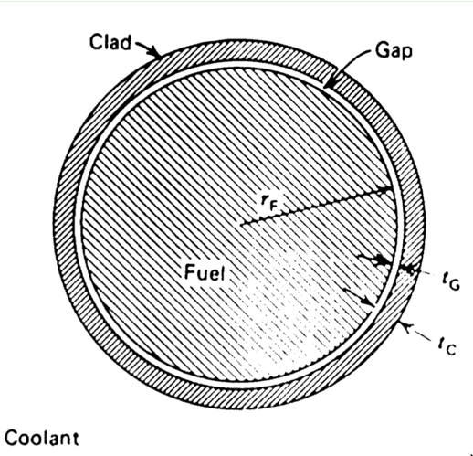
In order to solve, make assumptions!
#1: steady state ->
#2: axisymmetric ->
#3: constant in z
#4: constant thermal conductivity

Slide 7
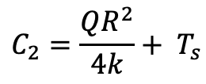
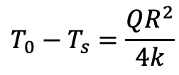
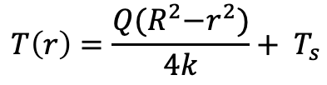
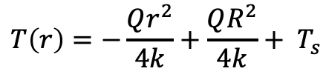
Directly Solving for Temperature Profile
Boundary conditions: r₀ = 0, r₁=R, T’(0) = 0, T(R) = T_{s}
r0
r1
$$C_{2}=\frac{QR^{2}}{4k}+ T_{s}$$
$$T\left(r\right)=−\frac{Qr^{2}}{4k}+\frac{QR^{2}}{4k}+ T_{s}$$
$$T\left(r\right)=\frac{Q{(R}^{2}−r^{2})}{4k}+ T_{s}$$
$$T_{0}−T_{s}=\frac{QR^{2}}{4k}$$

Slide 8
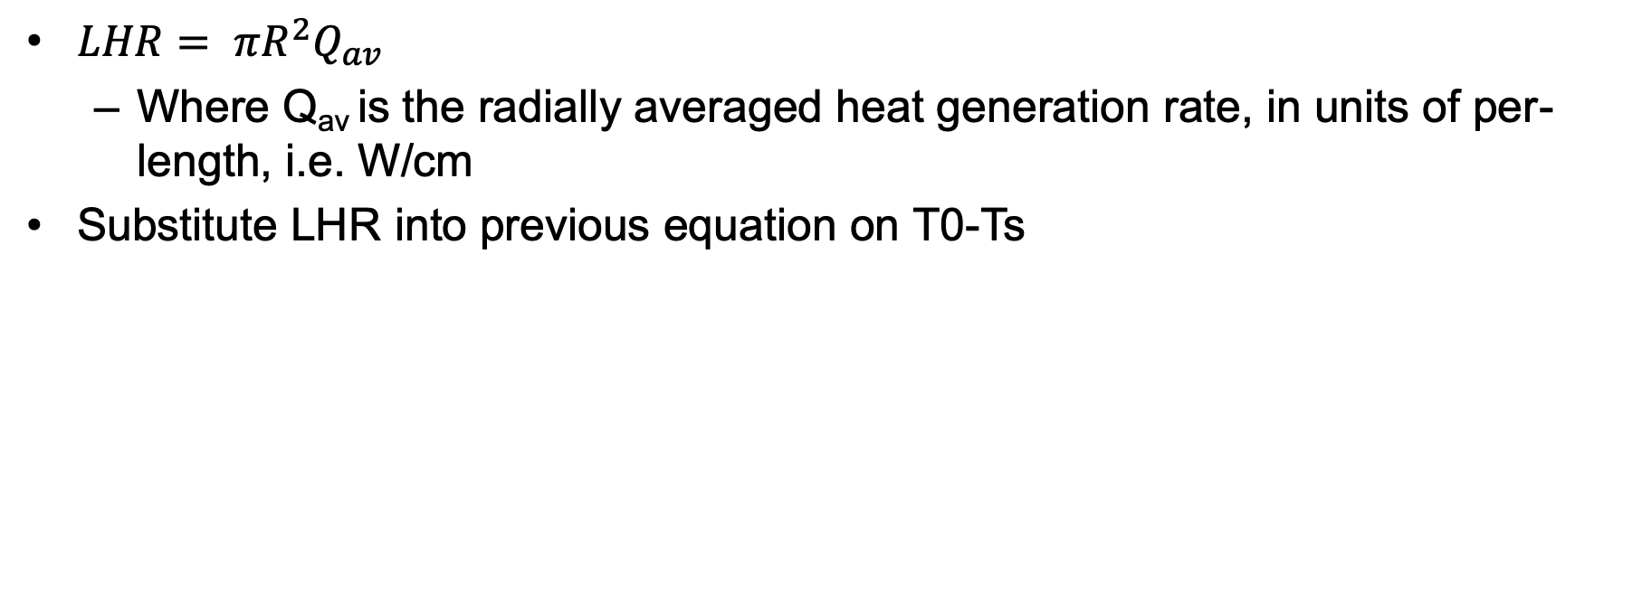
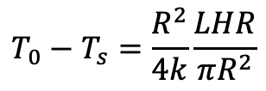
Linear Heat Rate
$LHR= πR^{2}Q_{av}$
Where Q_{av} is the radially averaged heat generation rate, in units of per-length, i.e. W/cm
Substitute LHR into previous equation on T0-Ts
$$T_{0}−T_{s}=\frac{R^{2}}{4k}\frac{LHR}{πR^{2}}$$

Slide 9
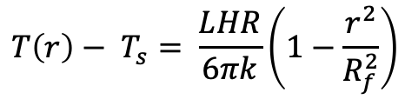
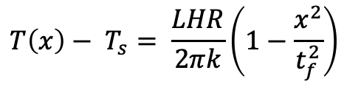
Alternate Geometries
Similar derivation with appropriate boundary conditions can be applied to plate and sphere geometries
Plate
Sphere
$$T\left(x\right)− T_{s}= \frac{LHR}{2πk}\left(1−\frac{x^{2}}{t_{f}^{2}}\right)$$
$$T\left(r\right)− T_{s}= \frac{LHR}{6πk}\left(1−\frac{r^{2}}{R_{f}^{2}}\right)$$
x is the distance from the midplane of the fuel and tf is the plate fuel thickness
r is the distance from the sphere center and Rf is the radius of the sphere

Slide 10
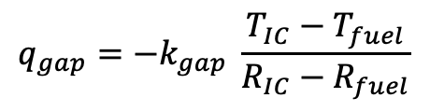
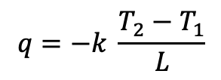
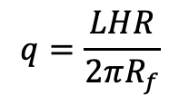
Heat transport through the gap
R₀=0
R₁=R_{f}
R₂=R_{IC}
The heat flux gives the rate, per unit area, at which heat flows in a given direction
The heat flux from the fuel is the LHR/pellet circumference
Heat flux from the fuel is the same as heat flux through the the gap – can make this assumption because R_{f} >> t_{g}
Gap thickness = R_{IC}-R_{f} = t_{g}
Cladding thickness = R_{OC}-R_{IC} = t_{c}
$$q=−k \frac{T_{2}−T_{1}}{L}$$
$$q_{gap}=−k_{gap} \frac{T_{IC}−T_{fuel}}{R_{IC}−R_{fuel}}$$
$$q=\frac{LHR}{2πR_{f}}$$
R₃=R_{OC}

Slide 11
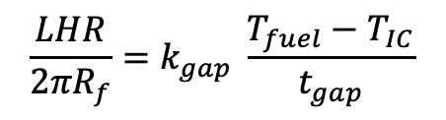
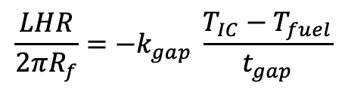
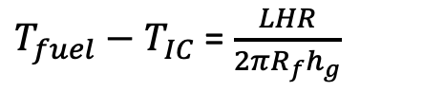
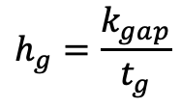
Heat transport through the gap
Set heat flux fuel/gap equal
Gap conductance is defined as:
Gap conductance depends on the gas filling the gap
For pure He, k_{gap}=16x10⁻⁶ * T^{0.79} (W/cm-K)
For pure Xe, k_{gap}=0.7x10⁻⁶ * T^{0.79} (W/cm-K)
Simple mixing rule: k_{gap} = k_{He}(1-y) + k_{Xe}y
Where y is the mole/atom fraction of Xe
$$\frac{LHR}{2πR_{f}}=−k_{gap} \frac{T_{IC}−T_{fuel}}{t_{gap}}$$
$$\frac{LHR}{2πR_{f}}=k_{gap} \frac{T_{fuel}−T_{IC}}{t_{gap}}$$
$$h_{g}=\frac{k_{gap}}{t_{g}}$$
$T_{fuel}−T_{IC}$ = $\frac{LHR}{2πR_{f}h_{g}}$

Slide 12
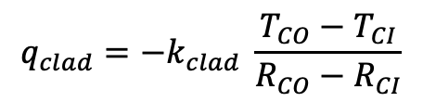
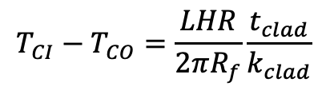
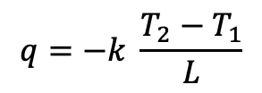
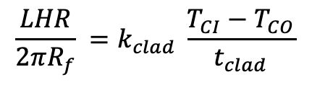
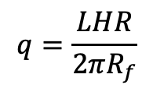
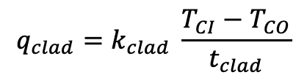
Heat transport through the cladding
$$q=−k \frac{T_{2}−T_{1}}{L}$$
$$q_{clad}=−k_{clad} \frac{T_{CO}−T_{CI}}{R_{CO}−R_{CI}}$$
Heat flux through the cladding
Set equal your heat fluxes
$$q=\frac{LHR}{2πR_{f}}$$
$$q_{clad}=k_{clad} \frac{T_{CI}−T_{CO}}{t_{clad}}$$
$$\frac{LHR}{2πR_{f}} =k_{clad} \frac{T_{CI}−T_{CO}}{t_{clad}}$$
$$T_{CI}−T_{CO}=\frac{LHR}{2πR_{f}}\frac{t_{clad}}{k_{clad}}$$

Slide 13
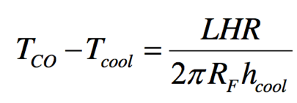
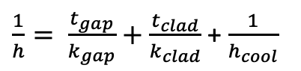
Heat transfer to the coolant
Heat is transported from the cladding to the coolant via convection
T_{cool} is the coolant temperature, h_{cool} is the convective heat transfer coefficient between cladding wall and coolant
Adding gap + cladding + coolant:
$\frac{1}{h}= \frac{t_{gap}}{k_{gap}}+$ $\frac{t_{clad}}{k_{clad}}$ + $\frac{1}{h_{cool}}$

Slide 14
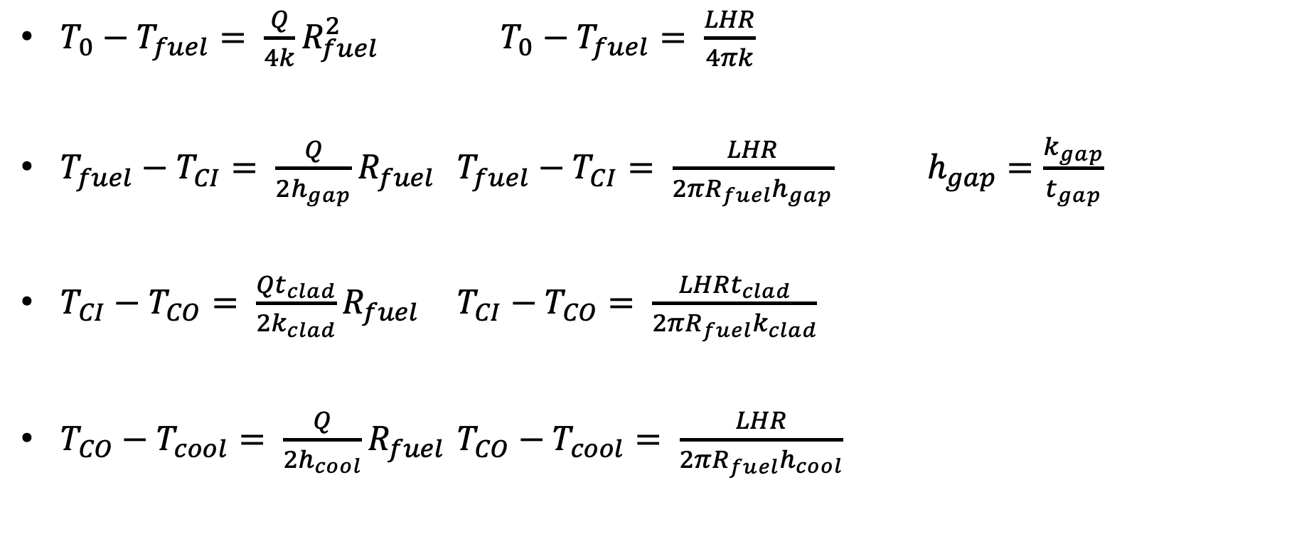
Summary of analytical solutions
$T_{0}−T_{fuel}= \frac{Q}{4k}R_{fuel}^{2}$ $T_{0}−T_{fuel}= \frac{LHR}{4πk}$
$T_{fuel}−T_{CI}= \frac{Q}{2h_{gap}}R_{fuel}$ $T_{fuel}−T_{CI}= \frac{LHR}{2{πR_{fuel}h}_{gap}}$ $h_{gap}=\frac{k_{gap}}{t_{gap}}$
$T_{CI}−T_{CO}= \frac{Qt_{clad}}{2k_{clad}}R_{fuel}$ $T_{CI}−T_{CO}= \frac{LHRt_{clad}}{2{πR_{fuel}k}_{clad}}$
$T_{CO}−T_{cool}= \frac{Q}{2h_{cool}}R_{fuel}$ $T_{CO}−T_{cool}= \frac{LHR}{2{πR_{fuel}h}_{cool}}$

Slide 15
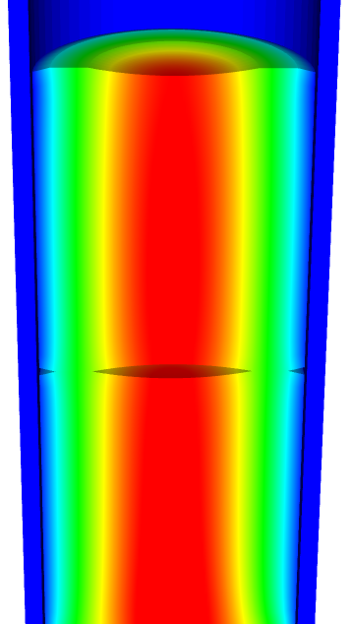
Solving for the temperature profile
T_{CO} T_{CI}
You first solve for the transition temperatures.
Start from the coolant and work inward
Have a linear profile everywhere except in the fuel
Finally, solve for the temperature profile throughout the fuel
T_{cool}

Slide 16
Fuel and Cladding Thermal Properties
Material | Density (g/cm³) | Heat Capacity Cp (J/g-K) | Thermal Conductivity k (W/cm-K) | Thermal Expansion Coefficient a (K⁻¹)
UO₂ | 10.98 | 0.33 | 0.03 | 1.2 x 10⁻⁵
Zr | 6.5 | 0.35 | 0.17 | 1.0 x 10⁻⁵
Stainless steel | 8.0 | 0.5 | 0.17 | 9.6 x 10⁻⁶

Slide 17
Example Problem

Slide 18
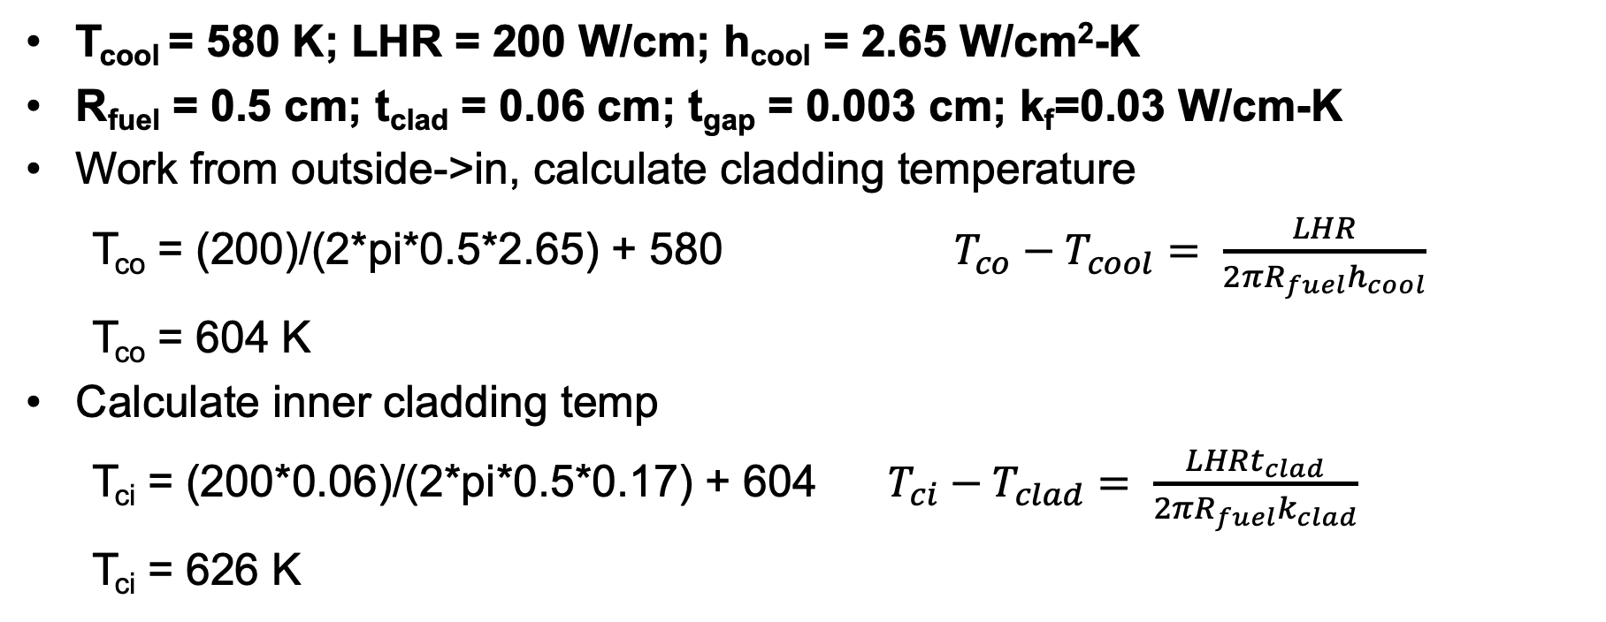
Temperature profile calculation example
T_{cool} = 580 K; LHR = 200 W/cm; h_{cool} = 2.65 W/cm²-K
R_{fuel} = 0.5 cm; t_{clad} = 0.06 cm; t_{gap} = 0.003 cm; k_{f}=0.03 W/cm-K
Work from outside->in, calculate cladding temperature
T_{co} = (200)/(2*pi*0.5*2.65) + 580 $T_{co}−T_{cool}= \frac{LHR}{2{πR_{fuel}h}_{cool}}$
T_{co} = 604 K
Calculate inner cladding temp
T_{ci} = (200*0.06)/(2*pi*0.5*0.17) + 604 $T_{ci}−T_{clad}= \frac{LHRt_{clad}}{2{πR_{fuel}k}_{clad}}$
T_{ci} = 626 K

Slide 19
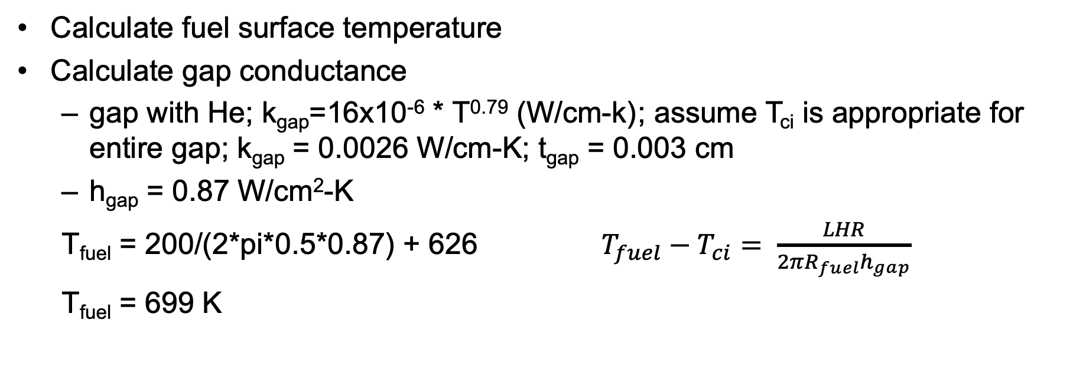
Temperature profile calculation example
Calculate fuel surface temperature
Calculate gap conductance
gap with He; k_{gap}=16x10⁻⁶ * T^{0.79} (W/cm-k) ; assume T_{ci} is appropriate for entire gap; k_{gap} = 0.0026 W/cm-K; t_{gap} = 0.003 cm
h_{gap} = 0.87 W/cm²-K
T_{fuel} = 200/(2*pi*0.5*0.87) + 626 $T_{fuel}−T_{ci}= \frac{LHR}{2{πR_{fuel}h}_{gap}}$
T_{fuel} = 699 K

Slide 20
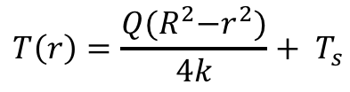
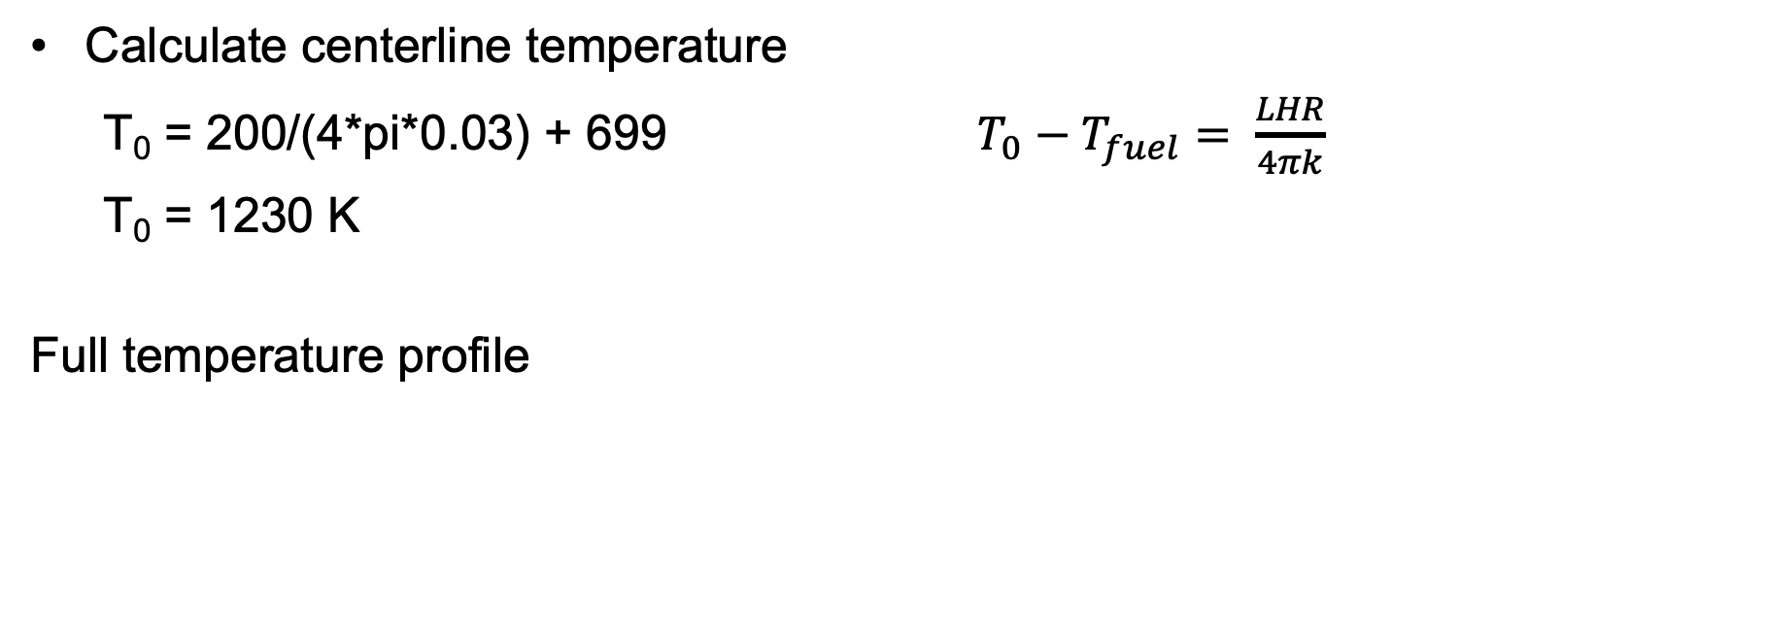
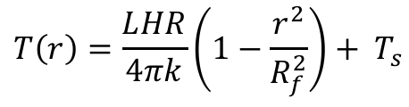
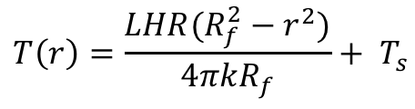
Temperature profile calculation example
Calculate centerline temperature
T₀ = 200/(4*pi*0.03) + 699 $T_{0}−T_{fuel}= \frac{LHR}{4πk}$
T₀ = 1230 K
Full temperature profile
$$T\left(r\right)=\frac{Q{(R}^{2}−r^{2})}{4k}+ T_{s}$$
$$T\left(r\right)=\frac{LHR(R_{f}^{2}−r^{2})}{4πkR_{f}}+ T_{s}$$
$$T\left(r\right)=\frac{LHR}{4πk}\left(1−\frac{r^{2}}{R_{f}^{2}}\right)+ T_{s}$$

Slide 21
Temperature profile calculation example
Parabolic temperature profile in fuel
Linear in gap and clad
Steep temperature drop over gap, very low thermal conductivity
Smaller temperature drop over cladding

Slide 22
Temperature profile modification
Instead of pure He gap, 30% of gas is Xe; how is T₀ affected?
First, how is gap conductance affected?
Gap conductance depends on the gas filling the gap
For pure He, k_{gap}=16x10⁻⁶ * T^{0.79} (W/cm-K)
For pure Xe, k_{gap}=0.7x10⁻⁶ * T^{0.79} (W/cm-K)
Simple mixing rule: k_{gap} = k_{He}(1-y) + k_{Xe}y
T_{CI}, T_{CO}, and T_{cool} is unchanged from previous example, also T₀-T_{fuel} is unchanged
k_{gap} = ((16x10⁻⁶)*(626)^{0.79} )(1-0.3) + ((0.7x10⁻⁶)*(626)^{0.79} )(0.3) = 1.85E-3 W/cm-K

Slide 23
Temperature profile modification
k_{gap} = 1.85E-3 W/cm-K
h_{gap} = 1.85E-3 / 0.003 = 0.62 W/cm²-K
T_{fuel} = 200/(2*pi*0.5*0.62) + 626 = 729 K
T₀ – T_{fuel} = 530.5 K (unchanged from before)
T₀ = 729 + 530.5 = 1259.5 K
Increase in T₀ of 30 K
Caveat: linear mixing of gases is not the best approach

Slide 24
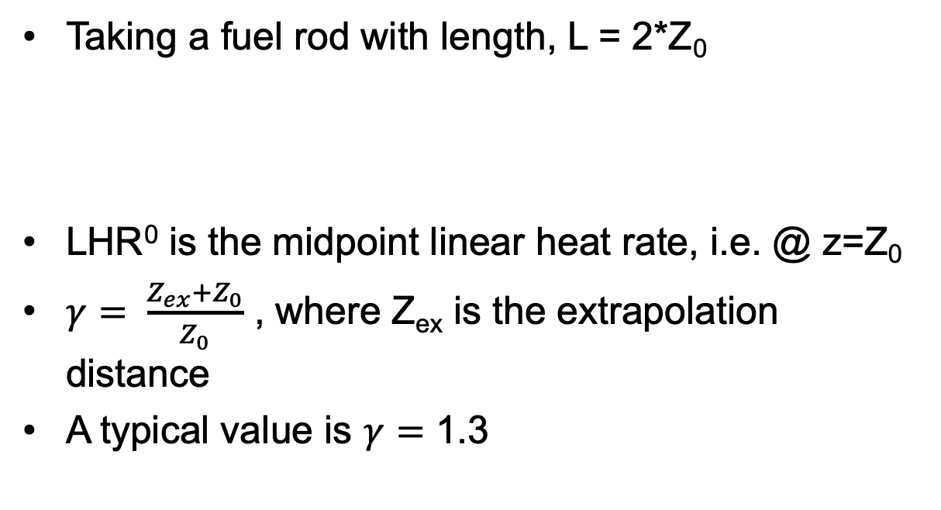
Neutron flux varies axially, so does LHR
Taking a fuel rod with length, L = 2*Z₀
LHR⁰ is the midpoint linear heat rate, i.e. @ z=Z₀
$γ= \frac{Z_{ex}+Z_{0}}{Z_{0}}$ , where Z_{ex} is the extrapolation distance
A typical value is $γ=$ 1.3

Slide 25
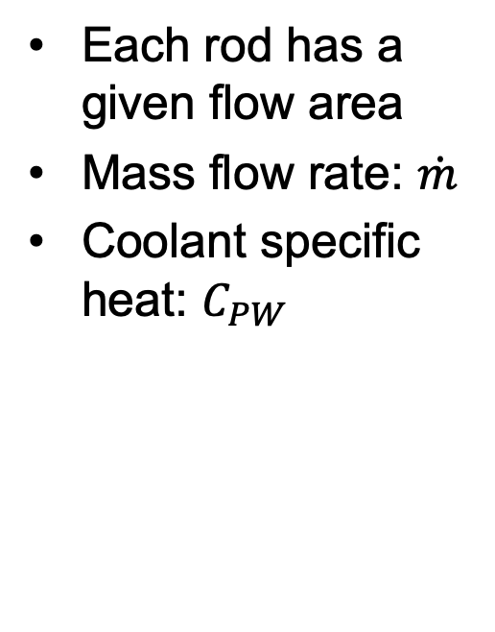
Coolant temperature varies with Z
Each rod has a given flow area
Mass flow rate: $\dot{m}$
Coolant specific heat: $C_{PW}$

Slide 26
Calculate LHR and T_{cool} with axial variation
mdot = 0.25 kg/s-rod; Z₀ = 150 cm; LHR⁰ = 150 W/cm; C_{PW} = 4200 J/kg-K; T_{in}= 570 K

Slide 27
Summary
Developed analytical expressions for the temperature profile within a fuel rod
Required to make four assumptions:
Steady-state solution
Temperature is axisymmetric
T is constant in Z
Thermal conductivity is independent of temperature
Temperature profile in the fuel is parabolic, assume linear profiles in gap, clad and coolant
Can incorporate axial variation in T_{cool} with axial variation in LHR

Slide 28
Thermal conductivity

Slide 29
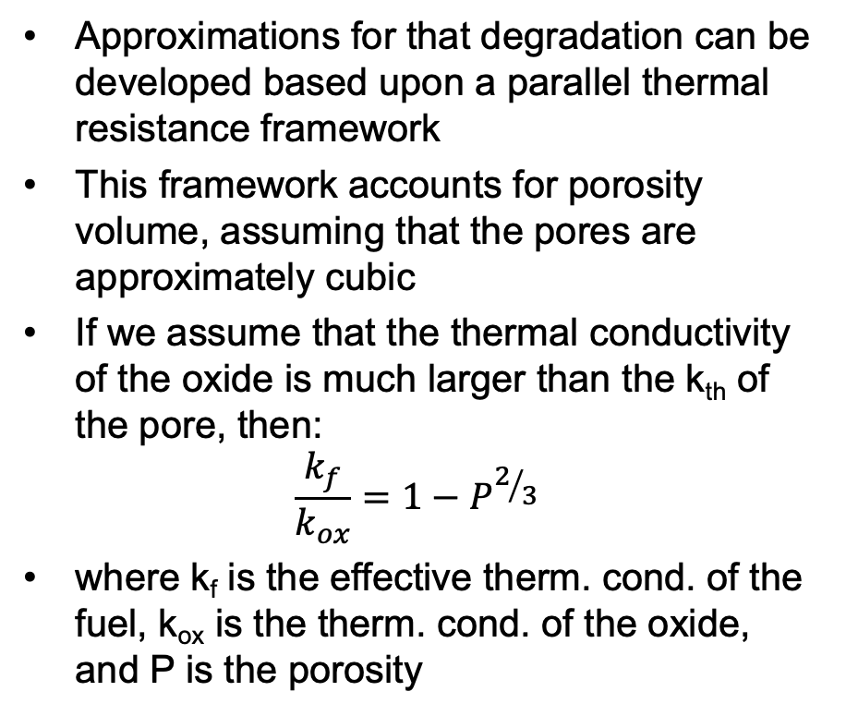
Thermal Conductivity
Knowledge of the thermal conductivity of the fuel, gap, and cladding is essential to determine the temperature distribution and transient thermal response
Sintering creates a porous oxide with about 95% theoretical density
The pores provide space to accommodate fission gases, and thus reduce swelling, but diminish the thermal conductivity
Additional porosity develops from fission gas accumulation
Porosity will degrade thermal conductivity
Approximations for that degradation can be developed based upon a parallel thermal resistance framework
This framework accounts for porosity volume, assuming that the pores are approximately cubic
If we assume that the thermal conductivity of the oxide is much larger than the k_{th} of the pore, then:
$$\frac{k_{f}}{k_{ox}}=1−P^{2/3}$$
where k_{f} is the effective therm. cond. of the fuel, k_{ox} is the therm. cond. of the oxide, and P is the porosity

Slide 30
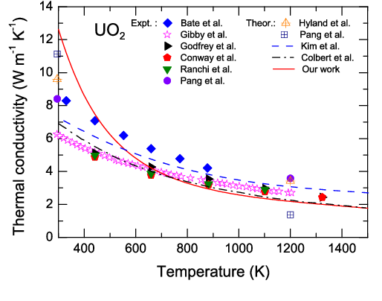
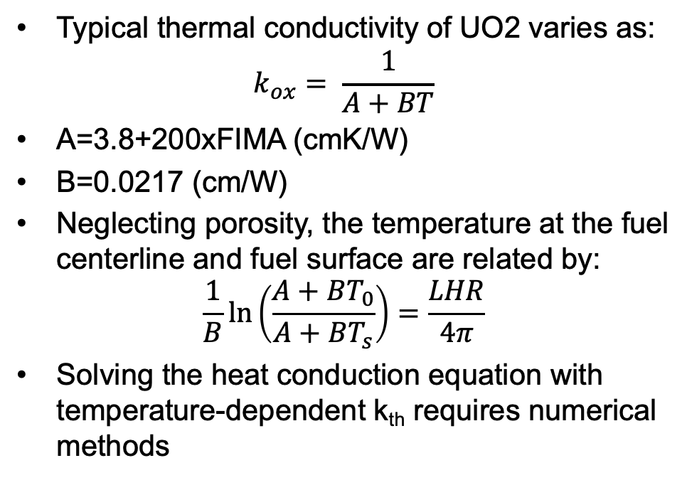
Thermal Conductivity
Typical thermal conductivity of UO2 varies as:
$$k_{ox}= \frac{1}{A+BT}$$
A=3.8+200xFIMA (cmK/W)
B=0.0217 (cm/W)
Neglecting porosity, the temperature at the fuel centerline and fuel surface are related by:
$$\frac{1}{B}\ln\left(\frac{A+BT_{0}}{A+BT_{s}}\right)=\frac{LHR}{4π}$$
Solving the heat conduction equation with temperature-dependent k_{th} requires numerical methods

Slide 31
Example

Slide 32
Operational Limits
Thermal limits are prescribed for normal operation and accident conditions, with the goal of avoiding fuel damage
Operational limits provide an envelope under which fuel failure will not occur
LHR limits
Centerline temperature limits
Pellet-Clad Mechanical Interaction Limits
will cover later in semester

Slide 33
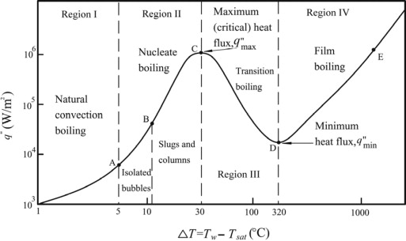
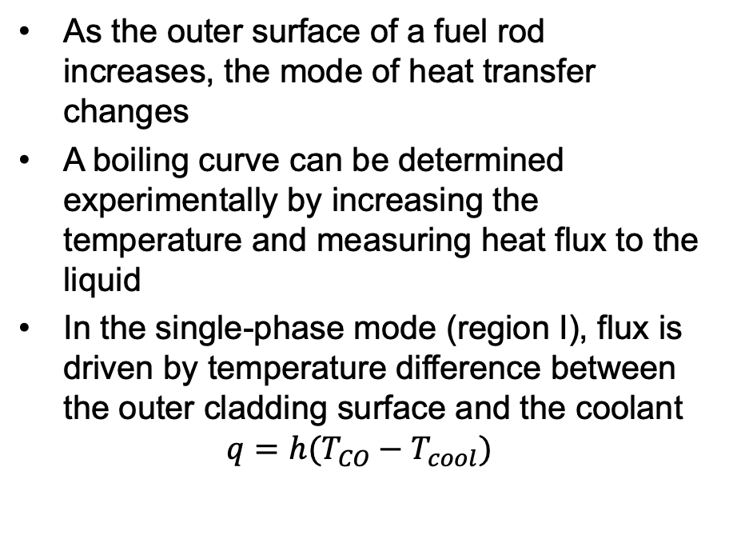
Critical Heat Flux
As the outer surface of a fuel rod increases, the mode of heat transfer changes
A boiling curve can be determined experimentally by increasing the temperature and measuring heat flux to the liquid
In the single-phase mode (region I), flux is driven by temperature difference between the outer cladding surface and the coolant
$$q=h(T_{CO}−T_{cool})$$

Slide 34
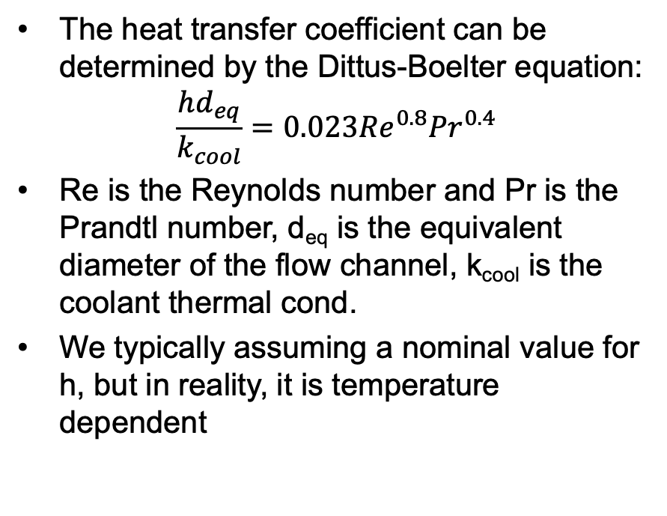
Critical Heat Flux
The heat transfer coefficient can be determined by the Dittus-Boelter equation:
$$\frac{hd_{eq}}{k_{cool}}=0.023{Re}^{0.8}{Pr}^{0.4}$$
Re is the Reynolds number and Pr is the Prandtl number, d_{eq} is the equivalent diameter of the flow channel, k_{cool} is the coolant thermal cond.
We typically assuming a nominal value for h, but in reality, it is temperature dependent

Slide 35
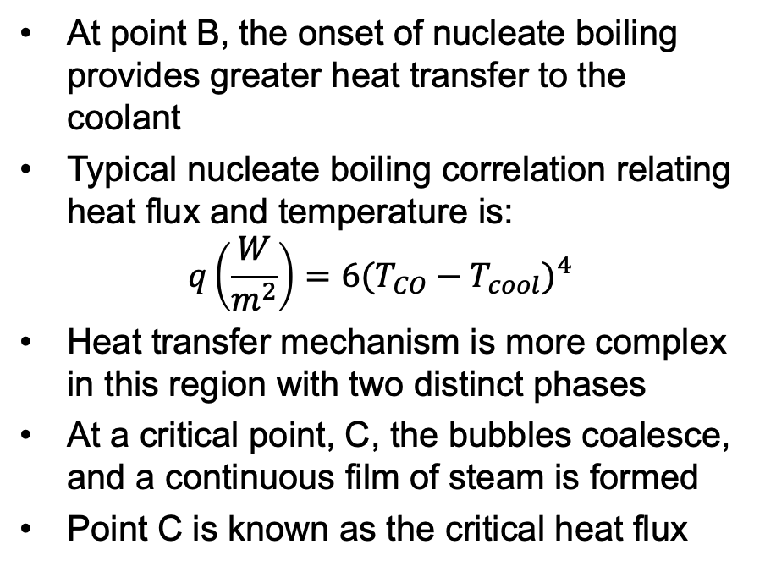
Critical Heat Flux
At point B, the onset of nucleate boiling provides greater heat transfer to the coolant
Typical nucleate boiling correlation relating heat flux and temperature is:
$$q\left(\frac{W}{m^{2}}\right)=6{(T_{CO}−T_{cool})}^{4}$$
Heat transfer mechanism is more complex in this region with two distinct phases
At a critical point, C, the bubbles coalesce, and a continuous film of steam is formed
Point C is known as the critical heat flux

Slide 36
Critical Heat Flux
Beyond point C the rod is ”coated” in steam and the heat flux is dramatically reduced
The heat transfer coefficient from cladding to steam is much lower than from cladding to water
T_{sat} is the saturation temperature, which is fixed for a given pressure, whereas the coolant temperature (T_{cool}) increases
Beyond point C, film boiling can occur

Slide 37
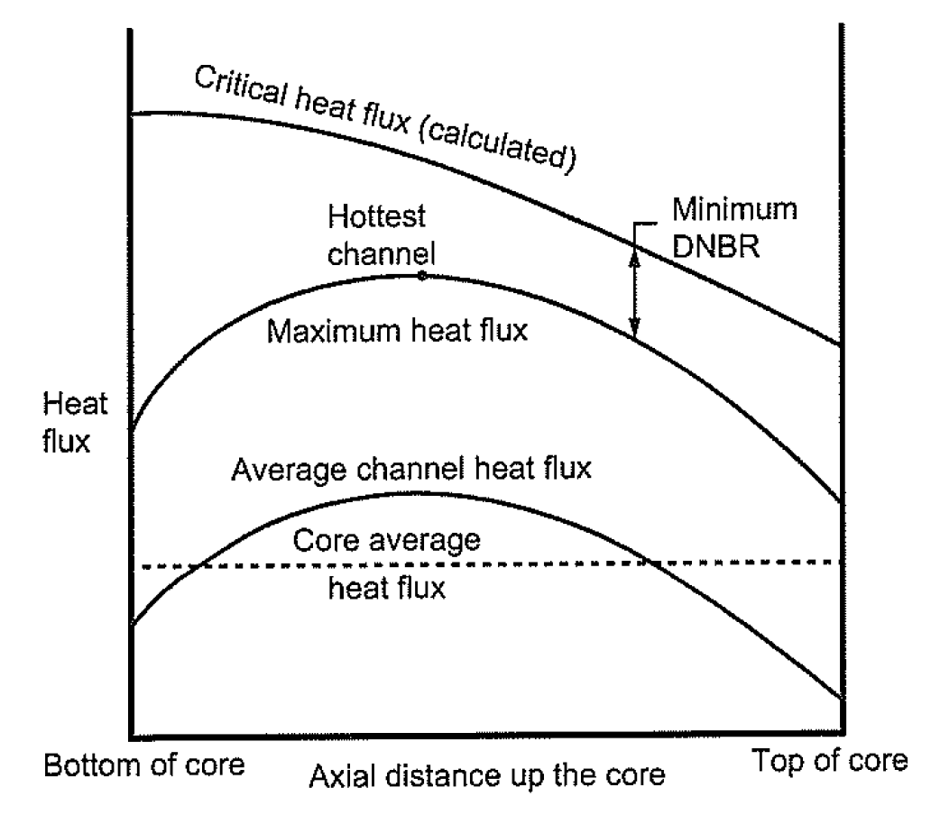
DNBR
The departure from nucleate boiling ratio (DBNR) is the ratio of the heat flux that causes dryout (the critical heat flux) to the actual heat flux
The limits on the DBNR in the hottest channel is 1.15 to 1.3, or a margin of 15-30 percent
The DNBR is determined by identifying the hottest channel, and the location where the heat flux most closely approaches the CHF
When CHF is reached, cladding temperature can increase to above 1100 K

Slide 38
Paper Project #1
Each of you will receive an email with a paper attached by the end of this week
This will be a critical review of the paper, similar to what we do for QE2, but much shorter
15 minute presentation that summarizes what was done in the paper, provides context on why it was done, and reviews what could or should have been done, or could be done next
Presentations will take place in class on Feb. 15
All presentations will be submitted via moodle
Distance students will also submit a recording of their presentation for review
If in person students prefer to submit recorded lectures, notify me
All submissions due by end of the day on Feb. 15
If you have a specific paper that you would like to review and applies to this topic field, present it to me and I will consider it

Slide 39
Problem Session

